Slide 1


AGENDA
SMASH THE FUNNEL
MIKE LIEBERMAN, SQUARE 2 MARKETING
BREAK & BOOK SIGNING
CREATING YOUR 2020 MARKETING STRATEGY
ERIC KEILES, SQUARE 2 MARKETING
REAL WORLD RESULTS
ANGELA POINTON, 11OUTOF11

Slide 2


THANK YOU
TO OUR
EVENT
SPONSORS!

Slide 3
SMASH THE FUNNEL: RETHINKING SALES AND MARKETING BY USING THE NEW SCIENCE OF REVENUE
MIKE LIEBERMAN
CEO AND CHIEF REVENUE SCIENTIST
SQUARE 2 MARKETING

Slide 4

I NEED YOUR HONEST ANSWER
ALL RISE AND REPEAT AFTER ME

Slide 5
HOW IS YOUR COMPANY DOING AT HITTING YOUR REVENUE GOALS?
REMAIN STANDING IF YOU HIT YOUR REVENUE GOALS LAST YEAR

Slide 6
HOW IS YOUR COMPANY DOING AT HITTING YOUR REVENUE GOALS?
REMAIN STANDING IF YOU HIT YOUR REVENUE GOALS LAST YEAR
REMAIN STANDING IF YOU HIT YOUR REVENUE GOALS DURING THE 1ST QUARTER THIS YEAR

Slide 7
HOW IS YOUR COMPANY DOING AT HITTING YOUR REVENUE GOALS?
REMAIN STANDING IF YOU HIT YOUR REVENUE GOALS LAST YEAR
REMAIN STANDING IF YOU HIT YOUR REVENUE GOALS DURING THE 1ST QUARTER THIS YEAR
REMAIN STANDING IF YOU HIT YOUR REVENUE GOALS DURING THE 2ND QUARTER THIS YEAR

Slide 8
HOW IS YOUR COMPANY DOING AT HITTING YOUR REVENUE GOALS?
REMAIN STANDING IF YOU HIT YOUR REVENUE GOALS LAST YEAR
REMAIN STANDING IF YOU HIT YOUR REVENUE GOALS DURING THE 1ST QUARTER THIS YEAR
REMAIN STANDING IF YOU HIT YOUR REVENUE GOALS DURING THE 2ND QUARTER THIS YEAR
REMAIN STANDING IF YOU'RE GOING TO HIT YOUR REVENUE GOALS DURING THE 3RD QUARTER THIS YEAR

Slide 9

“THERE’S NO QUESTION THAT SELLERS NOT HITTING THEIR TARGETS IS A REAL PROBLEM TODAY. ONE RECENT STUDY FOUND THAT 45.4% OF SALESPEOPLE MISS THEIR QUOTA.”

Slide 10

“ONLY 23% OF THOSE SURVEYED SAID THEY CONSISTENTLY HIT THEIR REVENUE GOALS.”

Slide 11


Slide 12


Slide 13
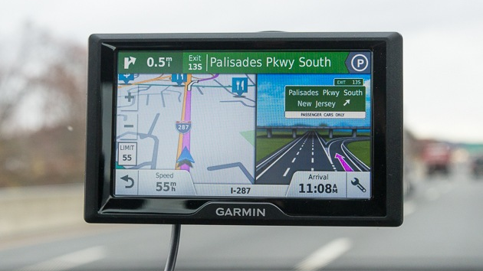

Slide 14
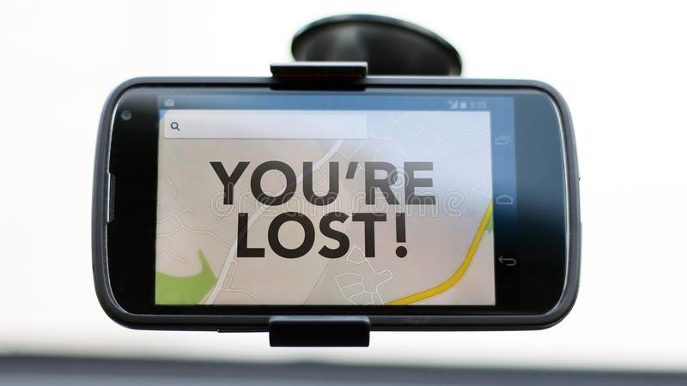

Slide 15
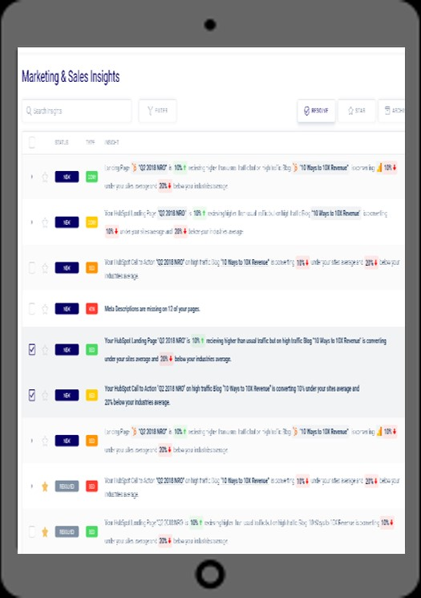
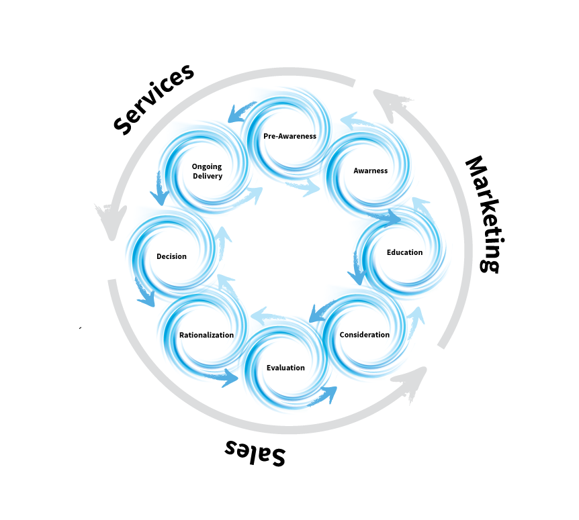
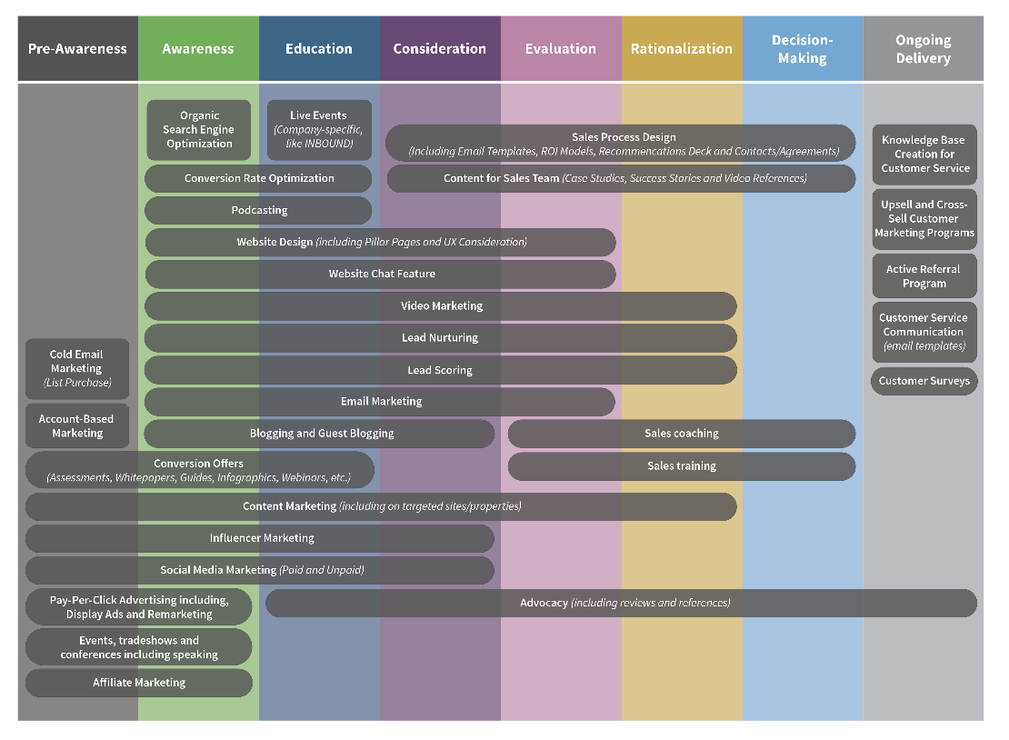
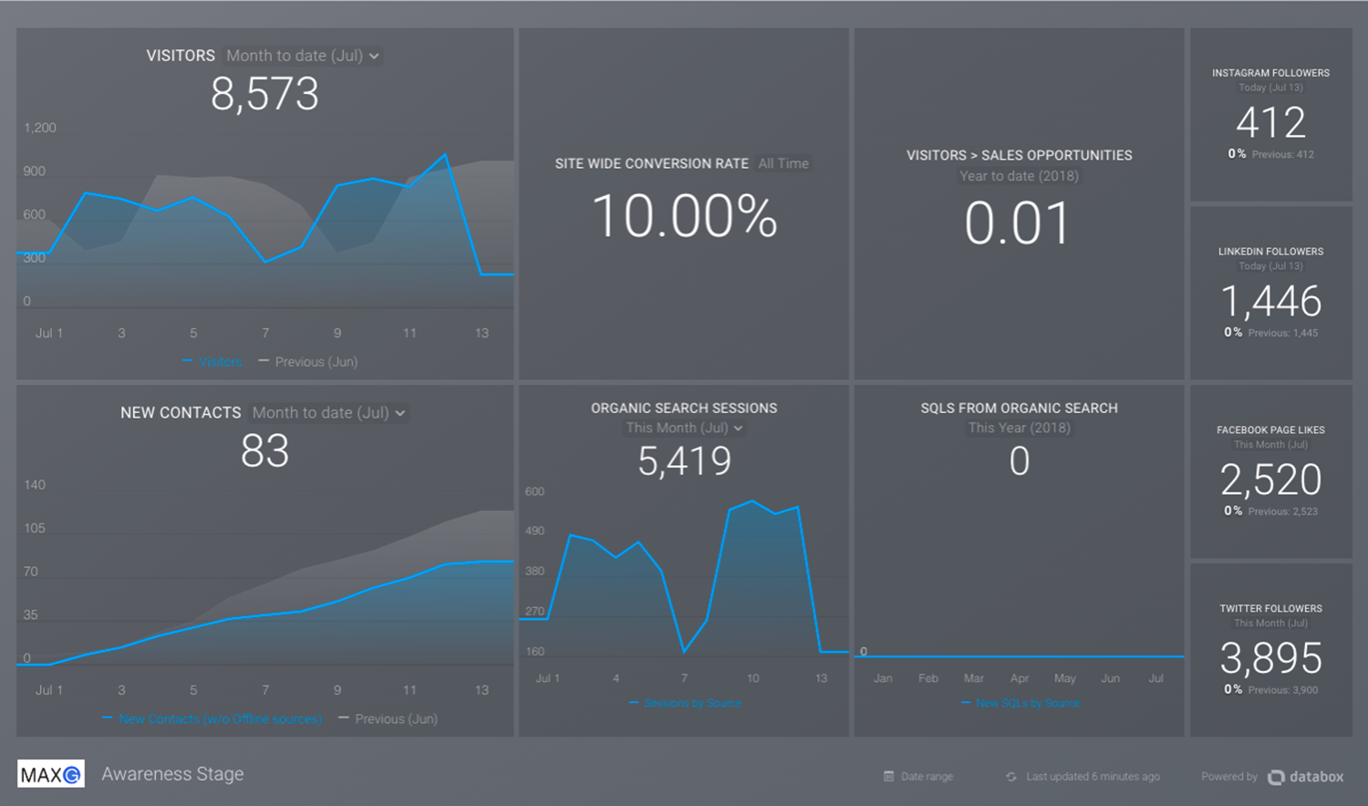
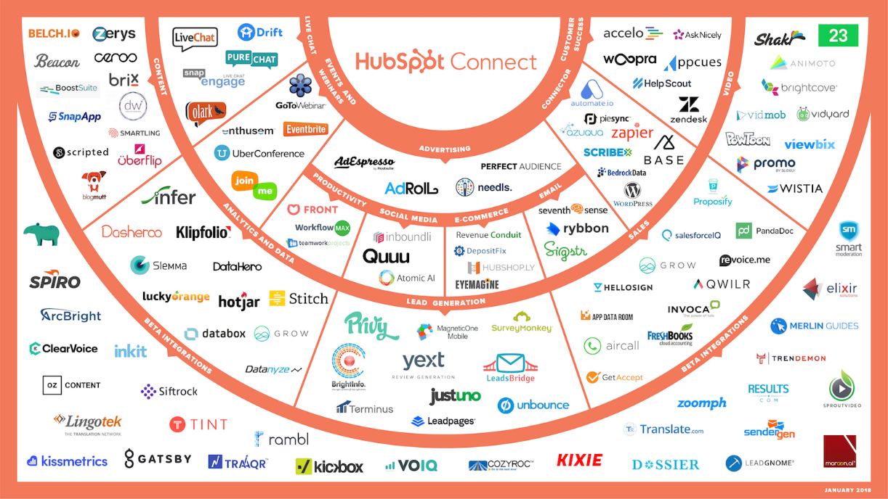
WHAT WE’RE GOING TO COVER TODAY
BONUS
THE NEW BUYER JOURNEY
HOW TO DEPLOY TACTICS
HOW TO MEASURE RESULTS
HOW TO USE TECHNOLOGY
HOW TO KNOW WHAT TO DO

Slide 16
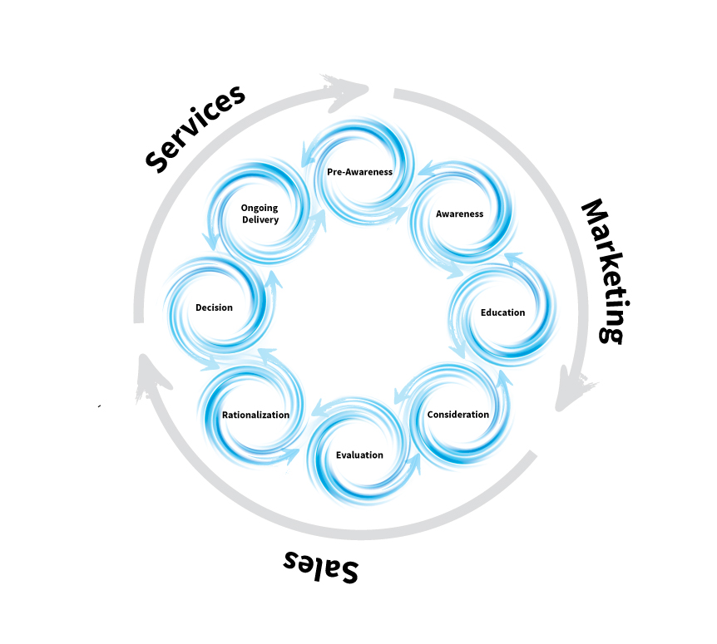
1
STRATEGY –
THE CYCLONIC BUYER JOURNEY™
Your Prospects Don’t Buy Like They Used To – Sales, Marketing And Customer Service Have To Change, Too!

Slide 17





HAVE YOU NOTICED?
EXTENDED SALES CYCLES
PROSPECT QUESTIONS
COMMITTEE BUYING
MORE DO NOTHING
DOWNWARD PRESSURE ON PRICE
People are taking longer to make their decision
People are asking many more questions
There are more people involved in the decision-making process, extended family members
If they’re not safe, they might do NOTHING
If they don’t know the real difference between facilities, the cheapest is always better

Slide 18

“THE AMOUNT OF CONTENT WE CONSUME ON A DAILY BASIS HAS GROWN FROM TWO HOURS A DAY IN THE 1920S TO NEARLY 11 HOURS PER DAY TODAY. PROPELLED BY MOBILE DEVICES, THE AVERAGE AMOUNT OF CONTENT WE CONSUME ON A DAILY BASIS HAS GONE UP BY TWO HOURS A DAY JUST IN THE LAST THREE YEARS!”

Slide 19
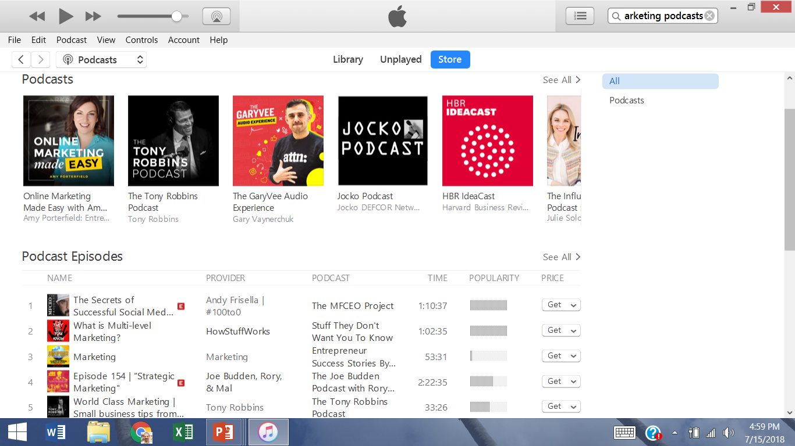
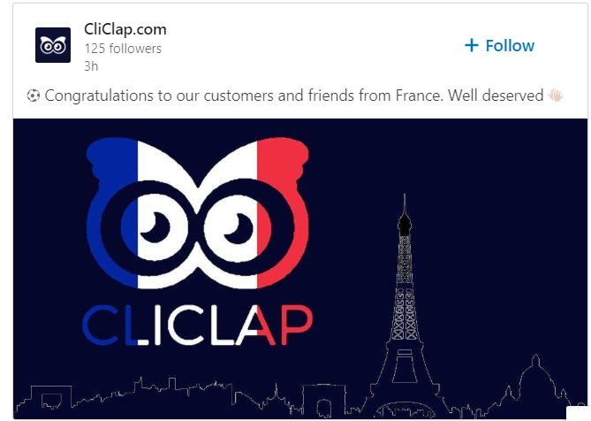
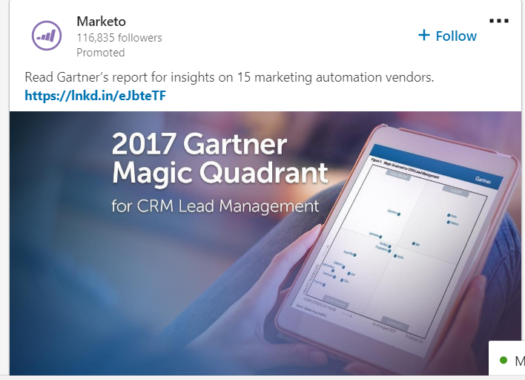
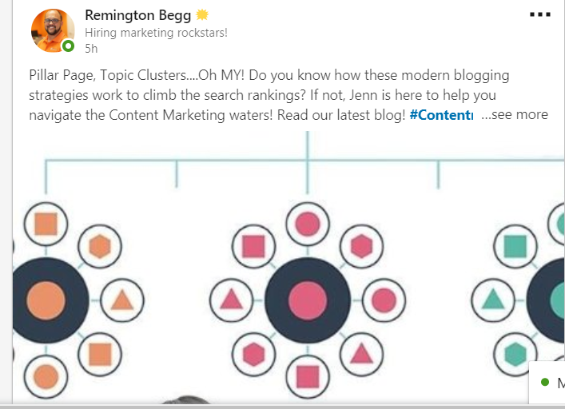
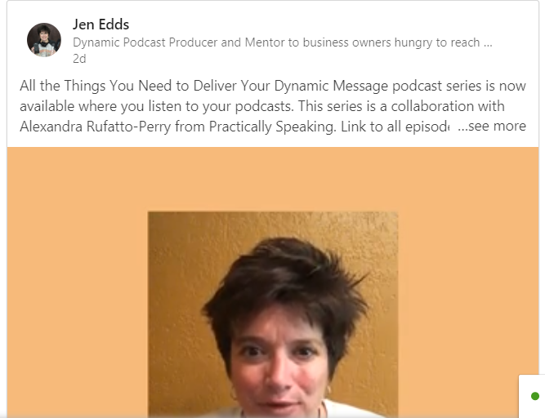
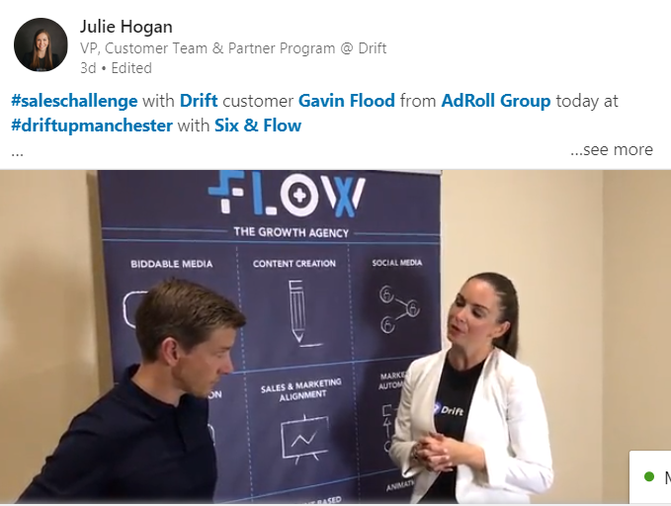
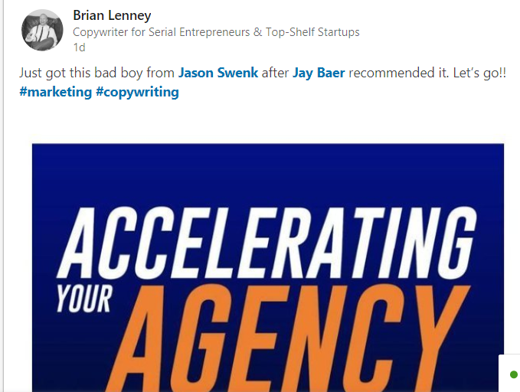
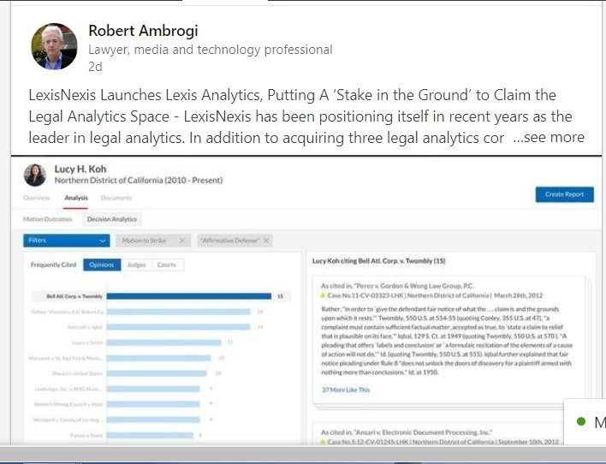
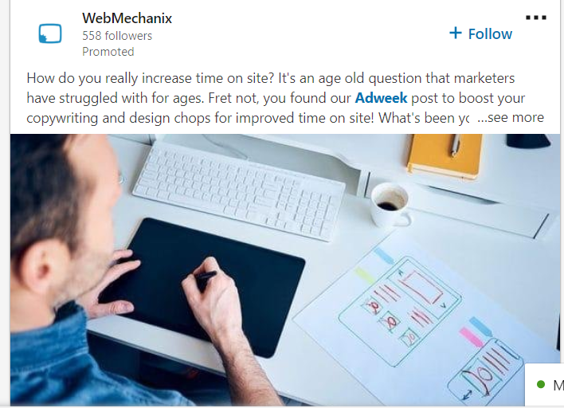
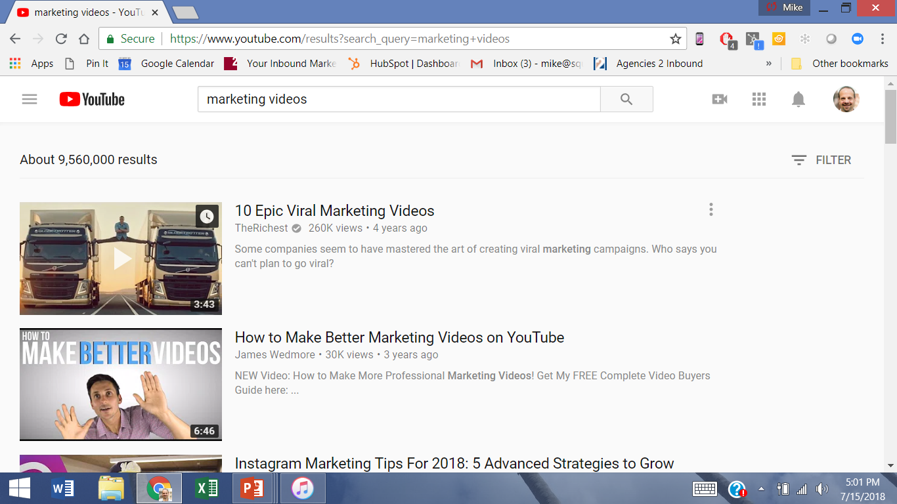

Slide 20

“FACED WITH A PLETHORA OF CHOICES AND COMMUNICATIONS, CONSUMERS TEND TO FALL BACK ON THE LIMITED SET OF BRANDS THAT HAVE MADE IT THROUGH THE WILDERNESS OF MESSAGES.”
TRANSLATED, THAT MEANS PROSPECTS AND CUSTOMERS ARE CONFUSED, AND WHEN PEOPLE ARE CONFUSED, THEY TEND TO DO WHAT’S SAFE, WHICH IS OFTEN NOTHING.

Slide 21
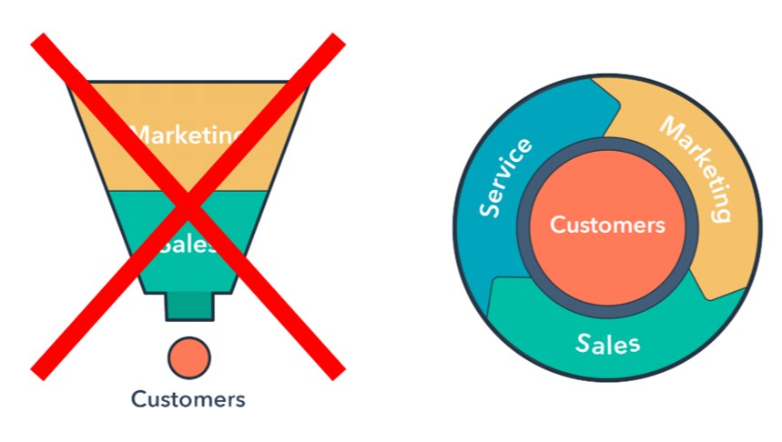

Slide 22
IN AN ARTICLE, JARED DODSON OF LENATI POINTED OUT THAT, “THE NEW SALES FUNNEL IS NOT A FUNNEL AT ALL; IT IS A COMPLEX WEB OF INDIVIDUAL BUYERS’ PATHS INTERSECTING AT VARIOUS SALES AND MARKETING TOUCH POINTS.”

Slide 23

“PEOPLE SAY THE SALES FUNNEL IS CHANGING – THAT, IN TODAY'S DIGITAL WORLD, THE WAY CUSTOMERS BUY IS NO LONGER A SIMPLE PATH FROM AWARENESS TO PROSPECT TO SALE.
THAT'S JUST NOT TRUE. THE SALES FUNNEL ISN'T CHANGING – IT'S COMPLETELY AND UTTERLY DEAD. IT'S BEEN BRUTALLY TURNED UPSIDE DOWN, INSIDE OUT, WITH LITTLE LEFT TO IDENTIFY IT AS THE CLEAN, STRAIGHTFORWARD PROCESS IT ONCE WAS.”

Slide 24

“RESEARCH REVEALED THAT THE CUSTOMER JOURNEY IS NOT RIGIDLY LINEAR, AS DEPICTED IN THE SALES FUNNEL MODEL, BUT RATHER CIRCULAR. IT IS A NETWORK OF TOUCH POINTS, DECISIONS AND OPPORTUNITIES THAT ARE EITHER APPROPRIATED OR REJECTED BY THE BUYER.”

Slide 25
AND…..

Slide 26
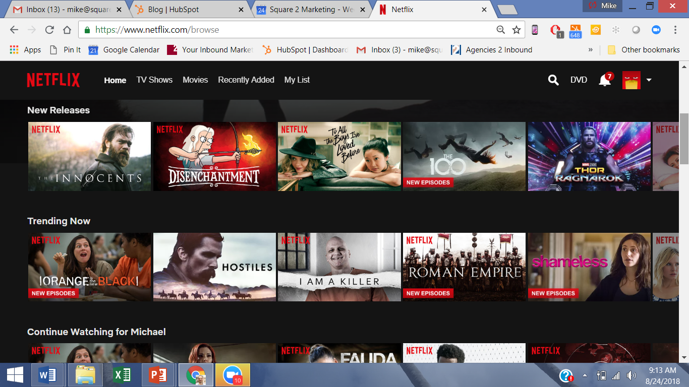

Slide 27
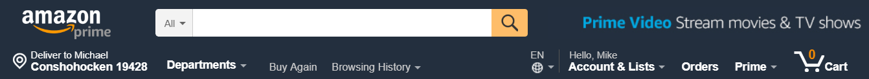
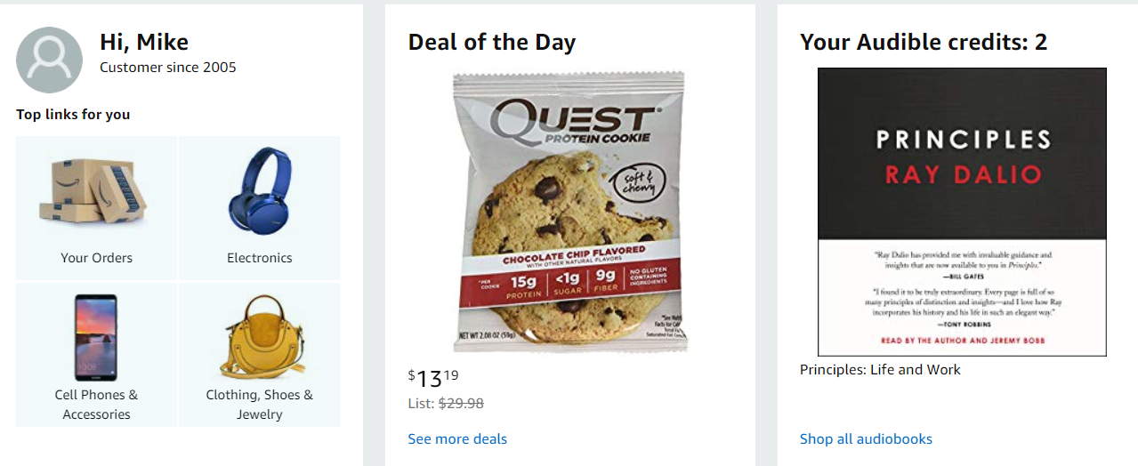
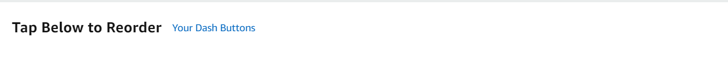

Slide 28
IF THE FUNNEL ISN’T THE MODEL…WHAT IS?

Slide 29


Slide 30


Slide 31


Slide 32

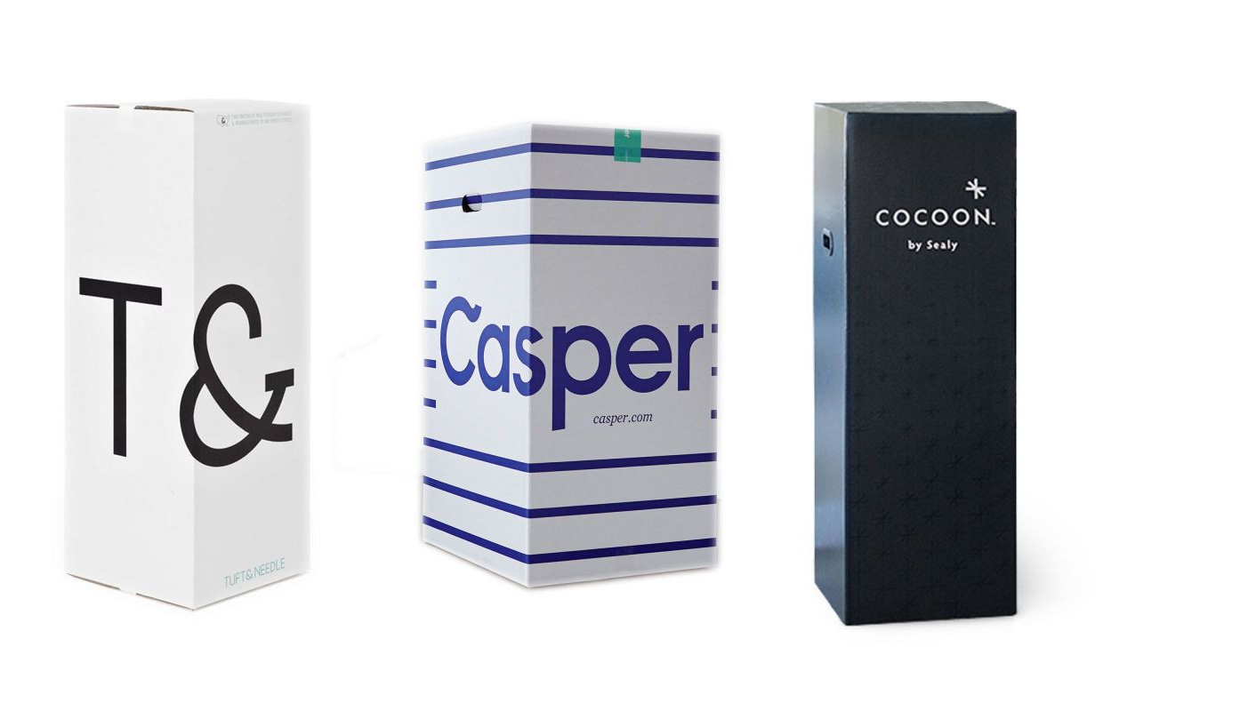
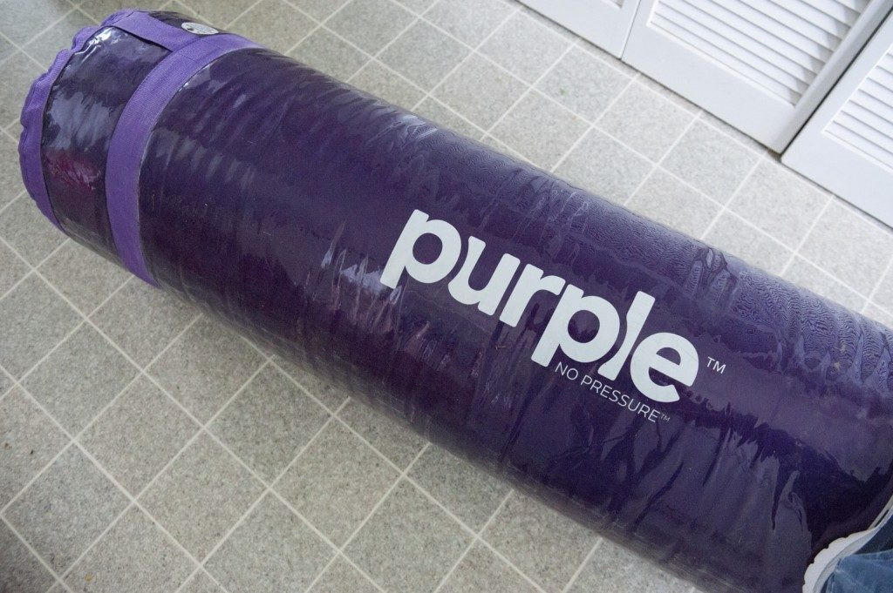

Slide 33

ADDING TO THE NOISE, ESTABLISHED RETAILERS ARE MOONLIGHTING WITH THEIR OWN ONLINE MATTRESS BRANDS. LAST YEAR, SERTA SIMMONS LAUNCHED TOMORROW SLEEP, A MATTRESS FIRM LAUNCHED TULO AND WALMART LAUNCHED ALLSWELL. AND THAT’S JUST THE TIP OF THE ICEBERG: THE LAST TIME I COUNTED, THERE WERE 178 DIFFERENT ONLINE MATTRESS BRANDS, WITH NEW ONES POPPING UP EVERY DAY.

Slide 34
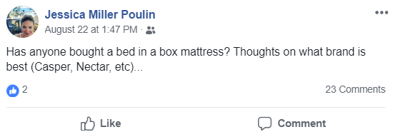

Slide 35
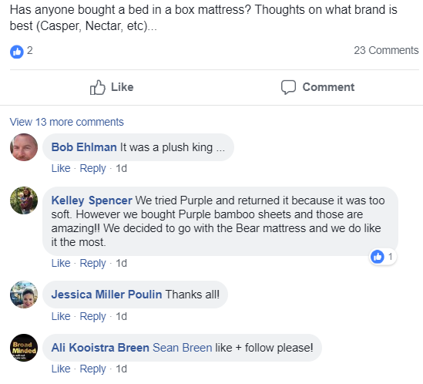

Slide 37

“THE NUMBER OF PEOPLE INVOLVED IN B2B SOLUTIONS PURCHASES HAS CLIMBED FROM AN AVERAGE OF 5.4 TWO YEARS AGO TO 6.8 TODAY.”

Slide 38
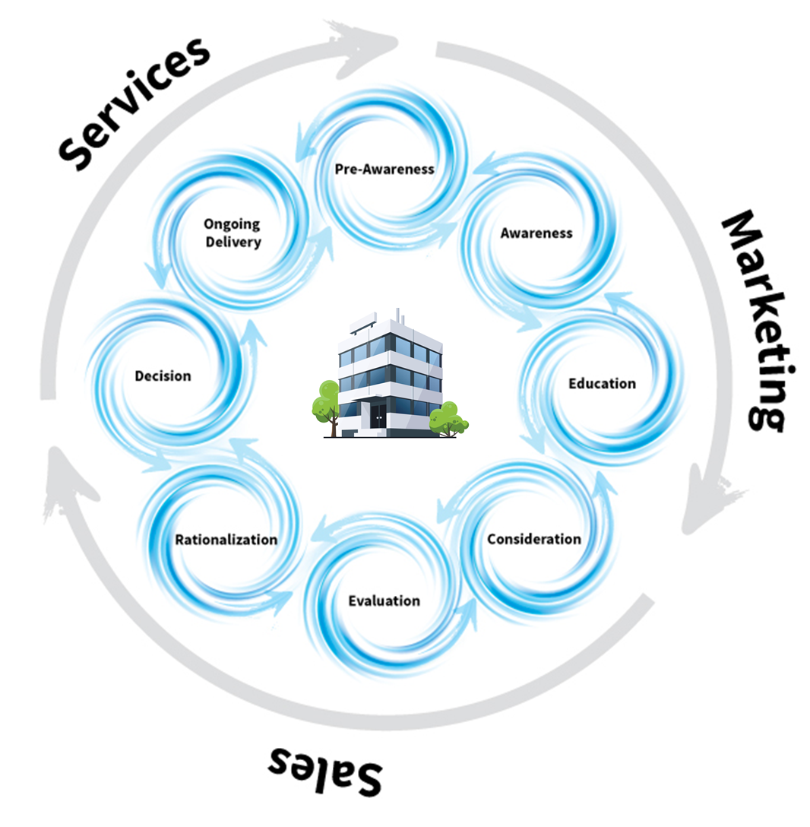

Slide 39
THE CYCLONIC
BUYER
JOURNEY™

Slide 40
PRE-AWARENESS
EVALUATION
AWARENESS
RATIONALIZATION
EDUCATION
DECISION
CONSIDERATION
DELIVERY
MARKETING
SALES
SERVICE

Slide 41
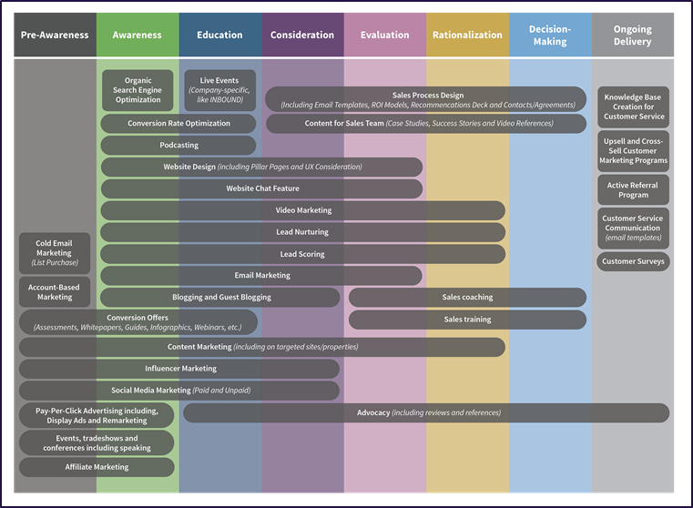
2
DEPLOYING TACTICS ALIGNED TO THE NEW BUYER JOURNEY
Tactics Span Across A Variety Of Buyer Journey Stages, Including Sales And Customer Service

Slide 43
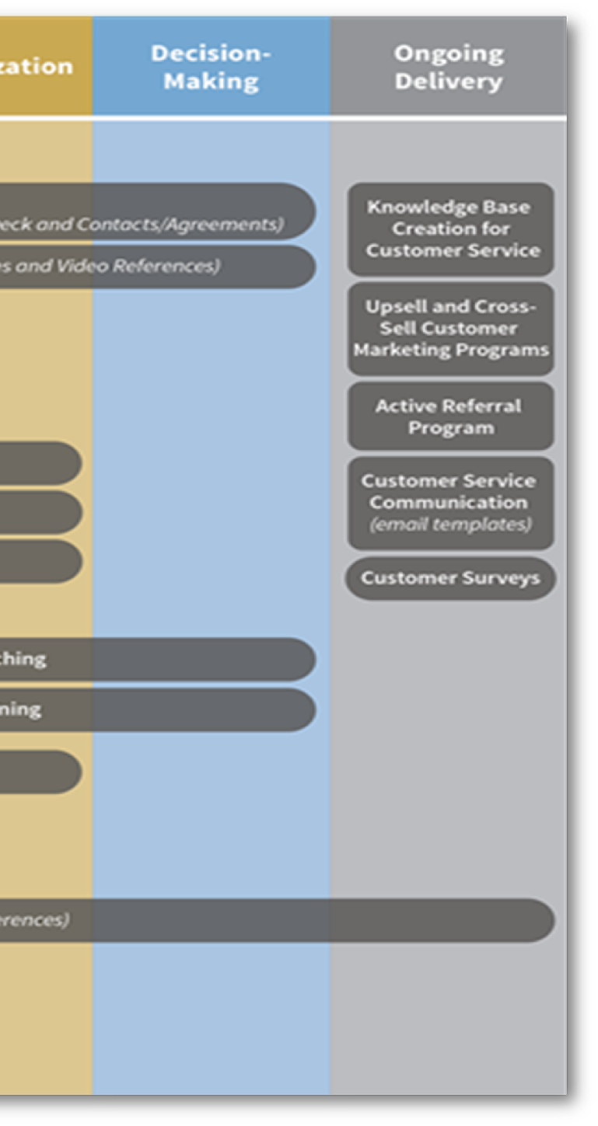
REVENUE GENERATION FROM CUSTOMER SERVICE TACTICS
EASY REVENUE FROM CURRENT CUSTOMERS

Slide 44
SALES MUST BE CONSIDERED AS PART OF THE BUYER JOURNEY EXPERIENCE
REMARKABLE SALES PROCESS WITH CONTENT IN CONTEXT

Slide 45
MIDDLE OF THE BUYER JOURNEY IS PACKED WITH HIGHLY EDUCATIONAL, ENTERTAINING CONTENT IN CONTEXT
THINK NETFLIX AND AMAZON

Slide 46
EARLY STAGE OF THE BUYER JOURNEY DEMANDS THE STORIES AND EXECUTION REQUIRED TO GRAB A PROSPECT’S ATTENTION
TRIED-AND-TRUE INBOUND MARKETING EXECUTION – BE THERE WHEN THEY’RE LOOKING FOR YOU

Slide 47
REVENUE GENERATION: SALES AND MARKETING ALIGNMENT WITH ABM AND TARGETED OUTREACH
TARGETED PROSPECT CAMPAIGNS – MESSAGING, DISRUPTION AND EMOTION ARE KEY

Slide 48
BUILD YOUR OWN TACTICS MAP

Slide 49
3
HOW TO MEASURE RESULTS
Stop Looking At Results By Tactic And Start Looking At Results By Buyer Journey Stage

Slide 50

The Metrics For The Cyclonic Buyer Journey
MAXG Generated Revenue Cycle Analysis Report, February 28, 2018
1 new customer every 2 months from marketing-
generated leads is $15,000 a month
3,000
30
20
4
2
1/2
2 new customers every month from marketing-
generated leads is $60,000 a month
10,000
200
100
20
10
5
Pre-Awareness
Awareness
Education
Consideration
Evaluation
Rationalization
Decision
Total Available Market
Website Visitors
New Contacts
Marketing Qualified Leads
Sales Qualified Leads
Sales Opportunities
Proposals Submitted
New Customers

Slide 51
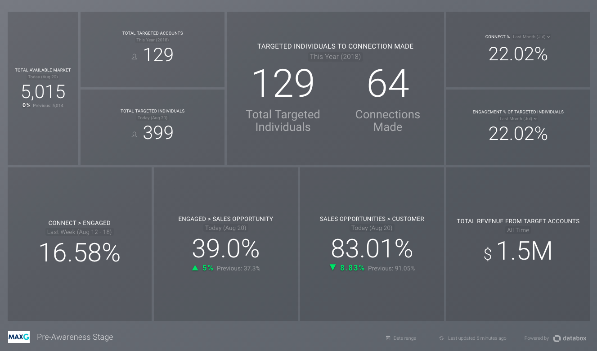
Month To Date
Month To Date
Month To Date
Month To Date
399 87 39
Targeted
Individuals
Connected
Engaged
Month To Date
9.77%
Month To Date
Month To Date
Month To Date
Month To Date
44.82%
▼8.83%

Slide 52
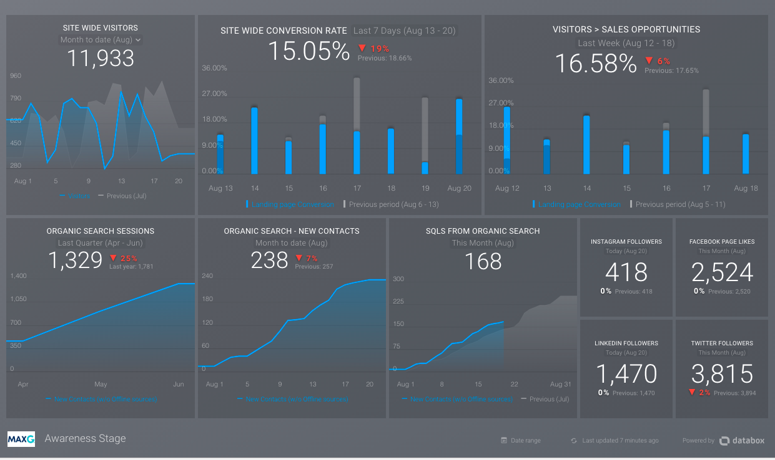

Month To Date
Last 7 Months
Last 7 Months
Month To Date
Month To Date
Month To Date

Slide 53
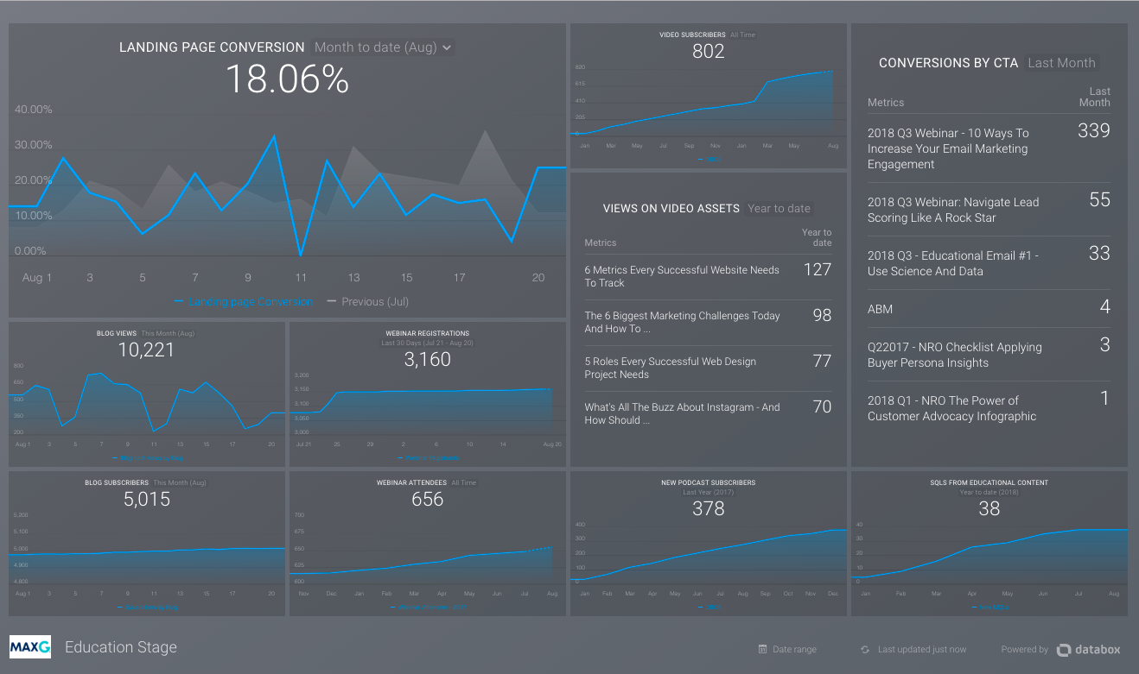
Month To Date
Month To Date
Month To Date
Month To Date
Month To Date
Month To Date

Slide 54
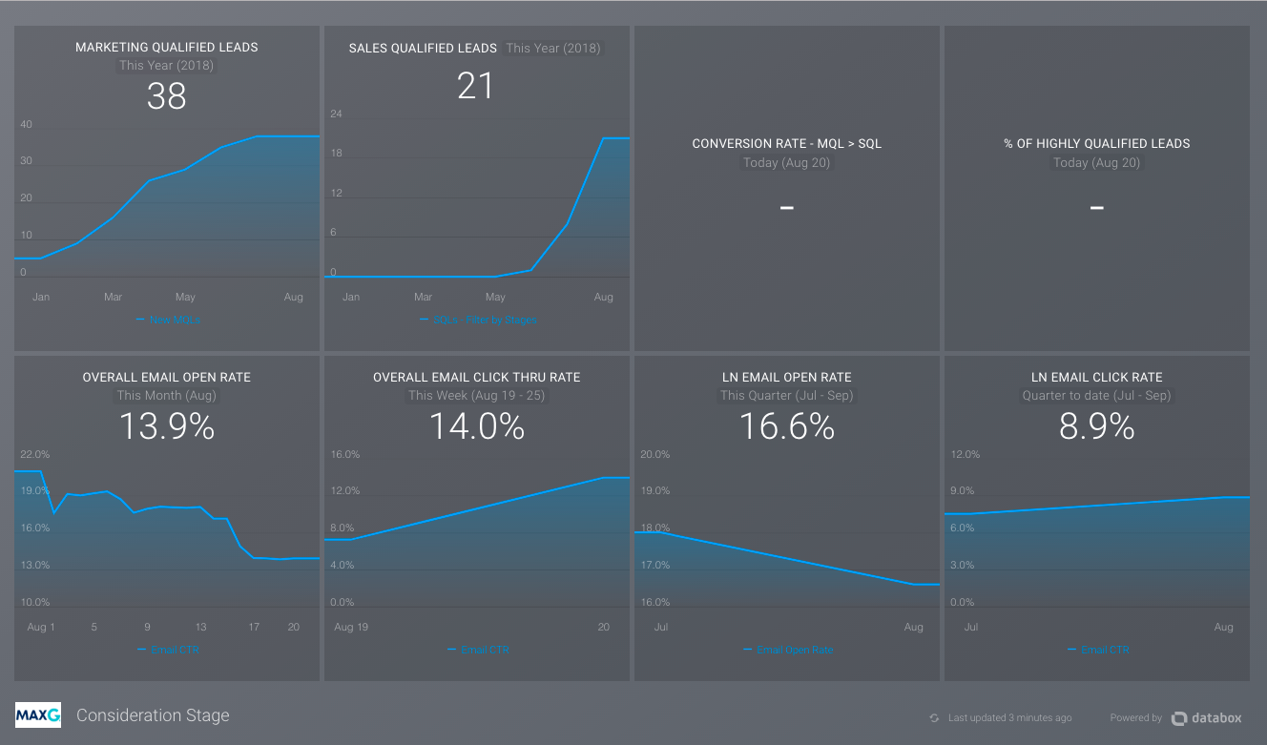

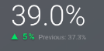
Month To Date
Month To Date
Month To Date
Month To Date
Month To Date
Month To Date
Month To Date
Month To Date
26.7%
10.77%
17.5%
8.55%
▲3.00%
Last Month 23.7%
▲1.10%
Last Month 9.67%
▲3.10%
Last Month 14.40 %
▲1.65%
Last Month 7.90 %

Slide 55
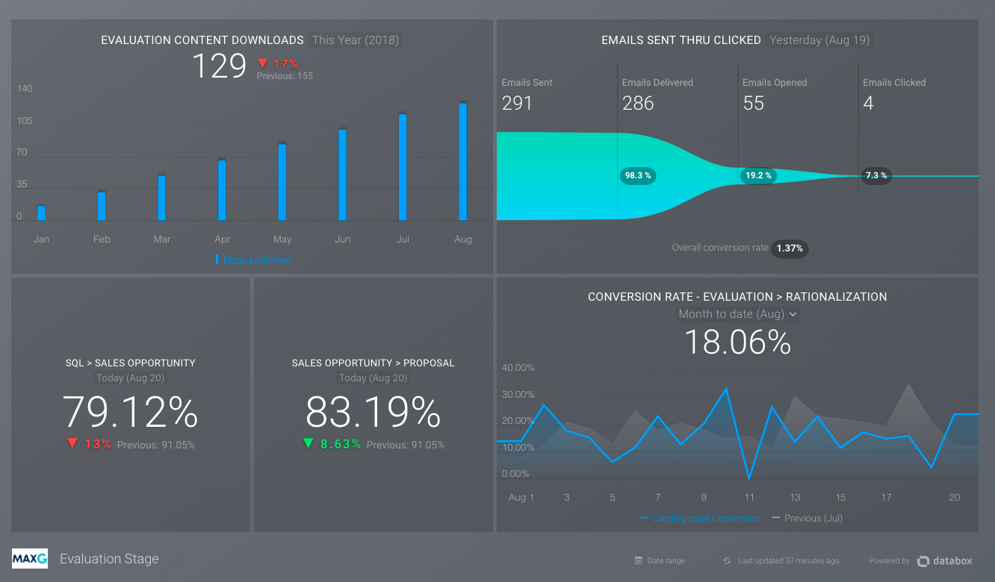
Month To Date
SALES
Month To Date
-- EVALUATION CONTENT
Month To Date
Month To Date
Month To Date
▲1.10%
Last Month 82.09%

Slide 56
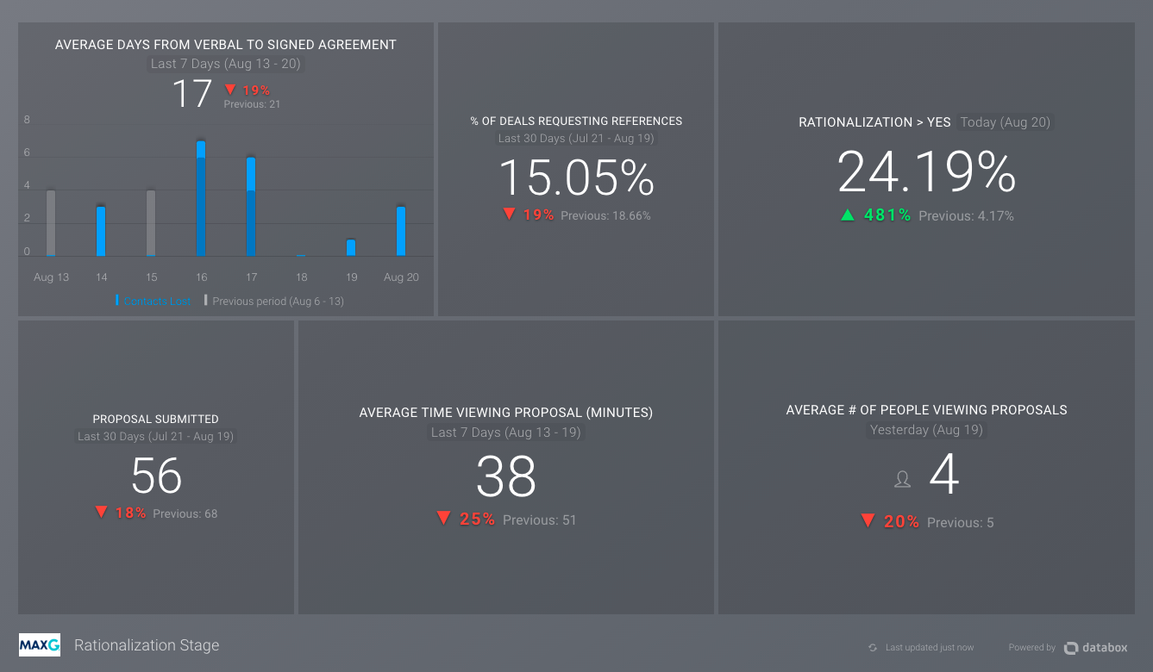
Month To Date
▼19%
Month To Date
Month To Date
95.77%
▼1.10%
Last Month 16.15%
▲2.20%
Last Month 93.57%
Year To Date
Month To Date
Month To Date

Slide 57
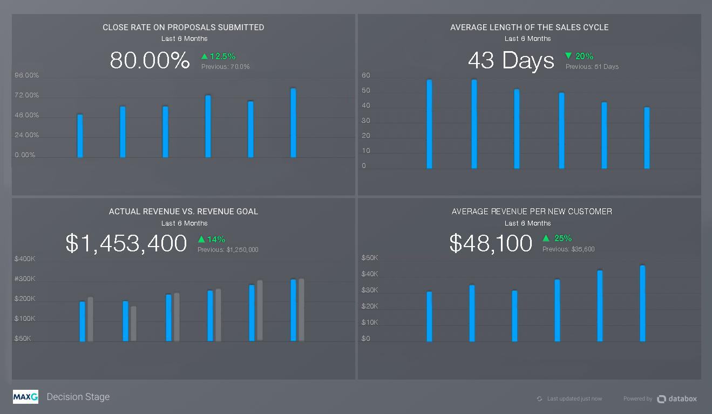

Slide 58
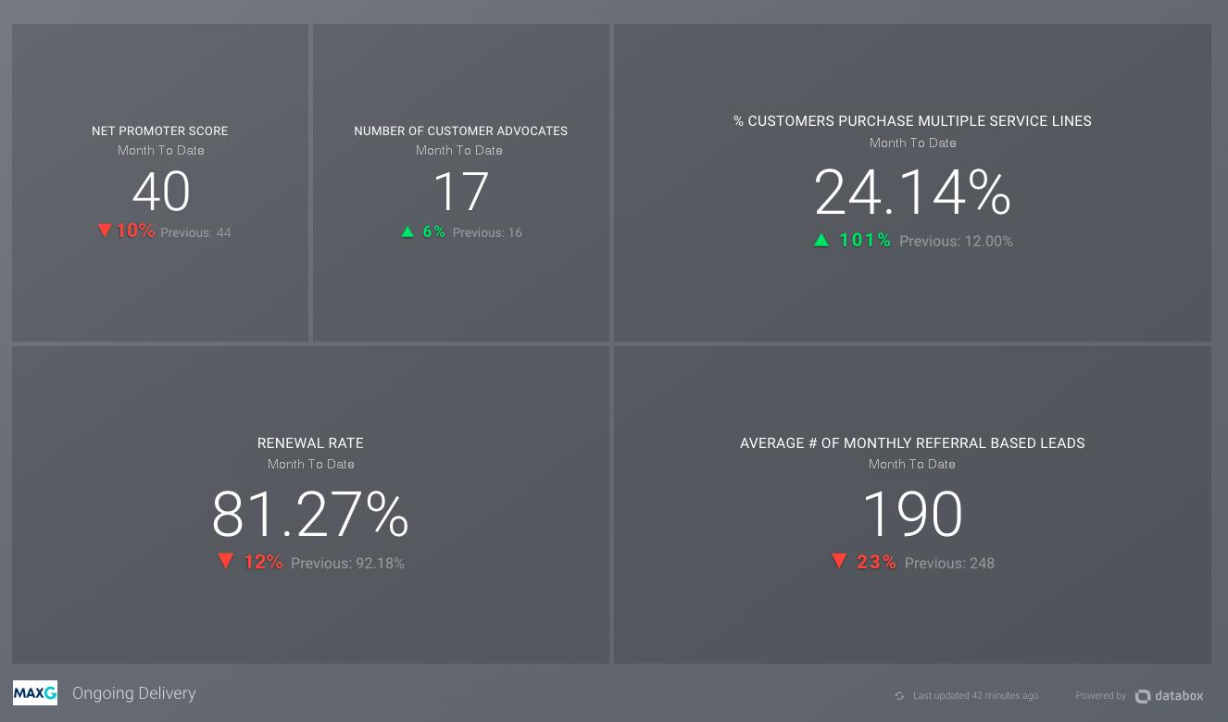

Slide 59
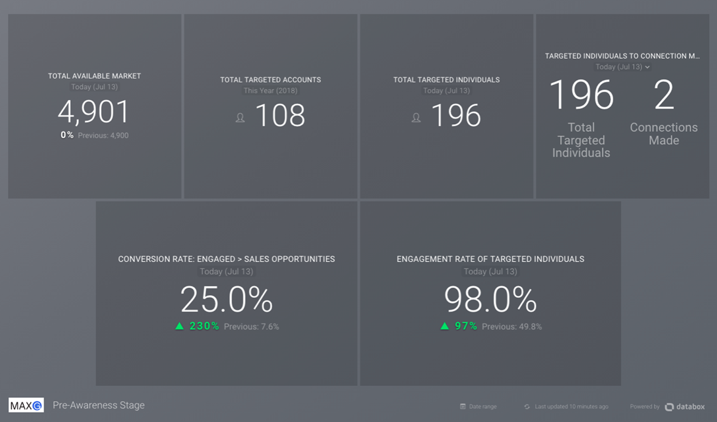
THE CYCLONIC
BUYER
JOURNEY™

Slide 60

4
USING TECHNOLOGY STRATEGICALLY TO GENERATE BETTER RESULTS
Platform Technology For Basic Support And Advanced Technology For Tactics That Require Advanced Features

Slide 61
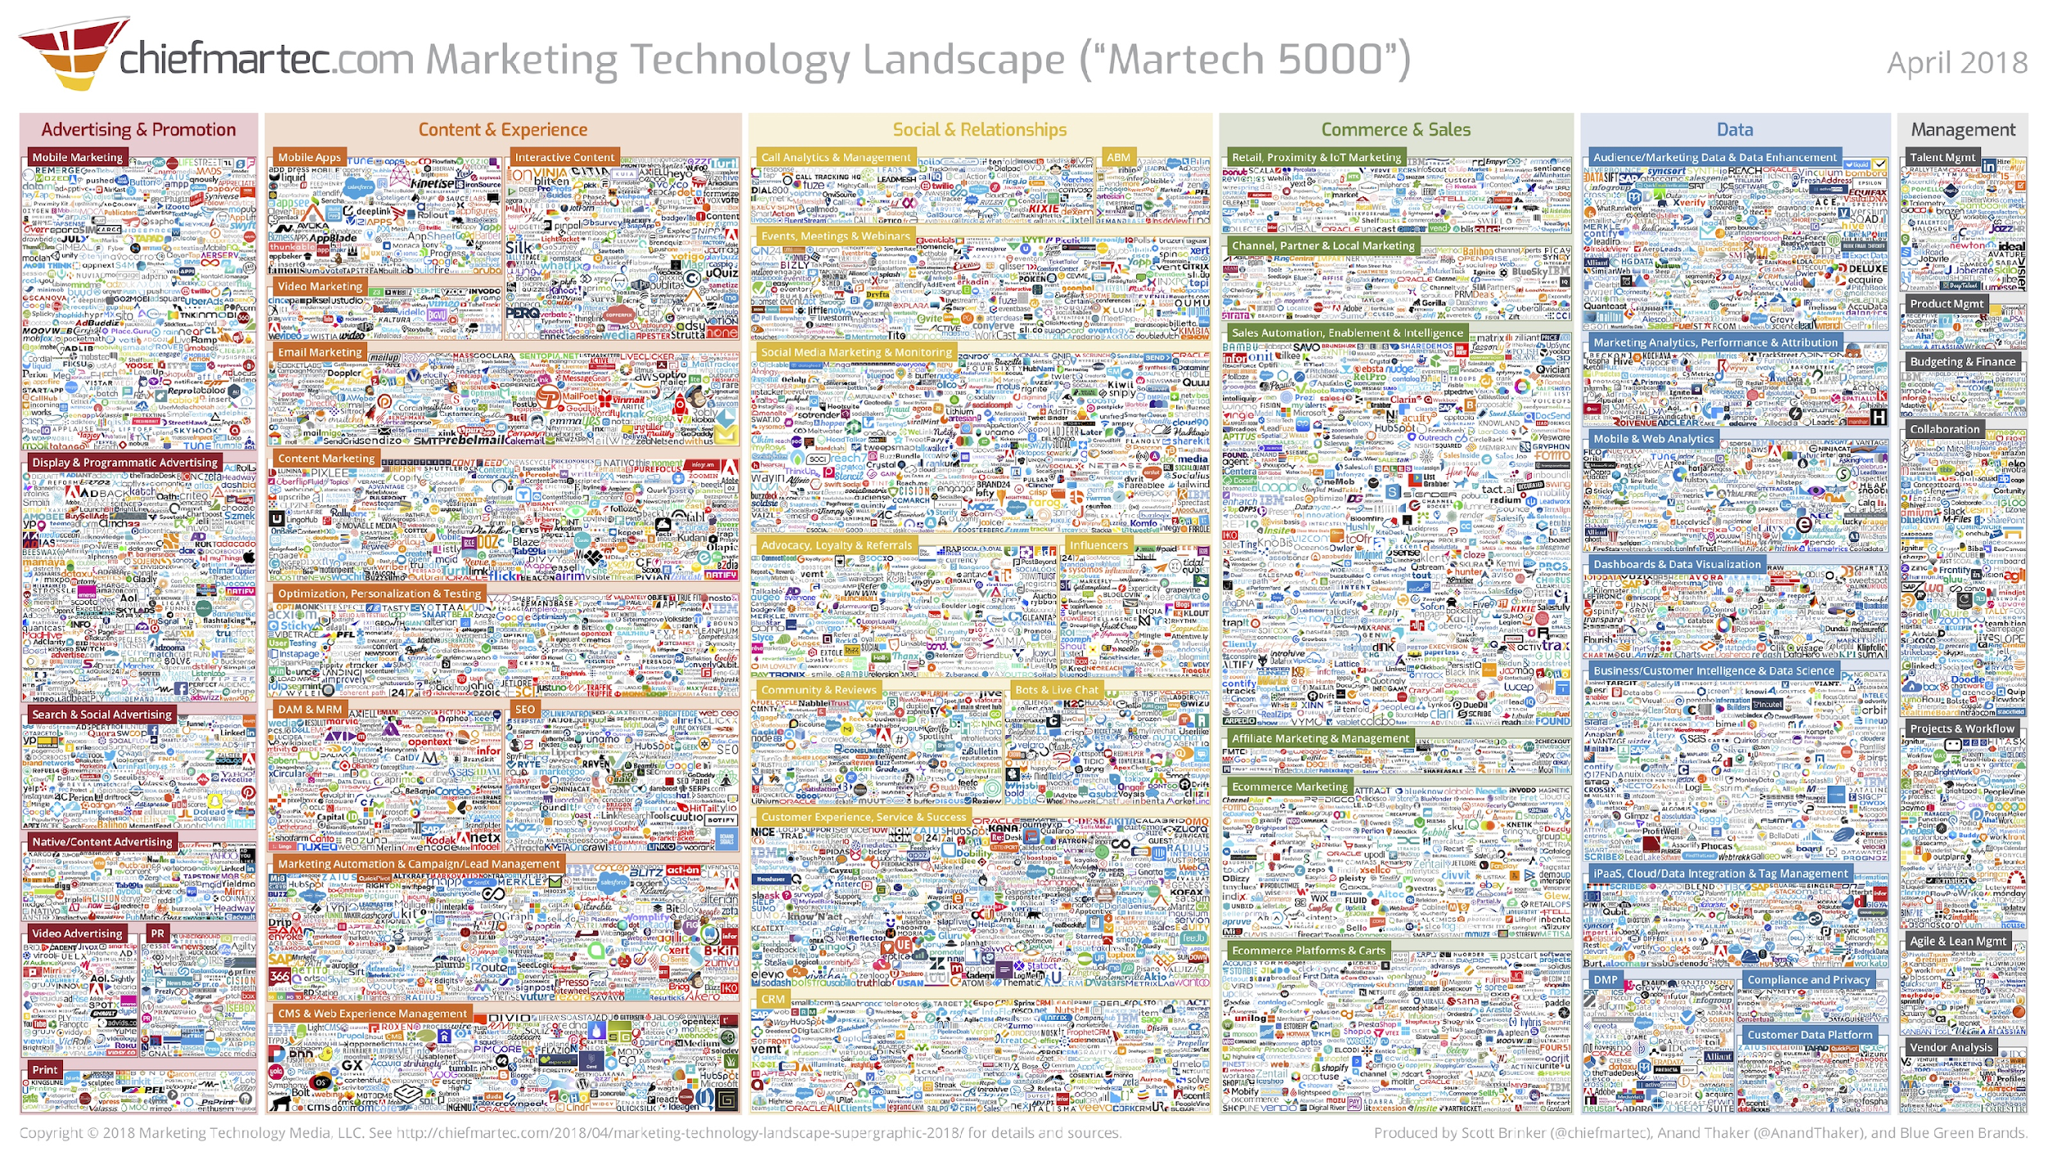

Slide 62
7,000

Slide 63







A BUYER-JOURNEY-CENTRIC APPROACH TO SOFTWARE AND TECHNOLOGY
PLATFORM TECHNOLOGY

Slide 64
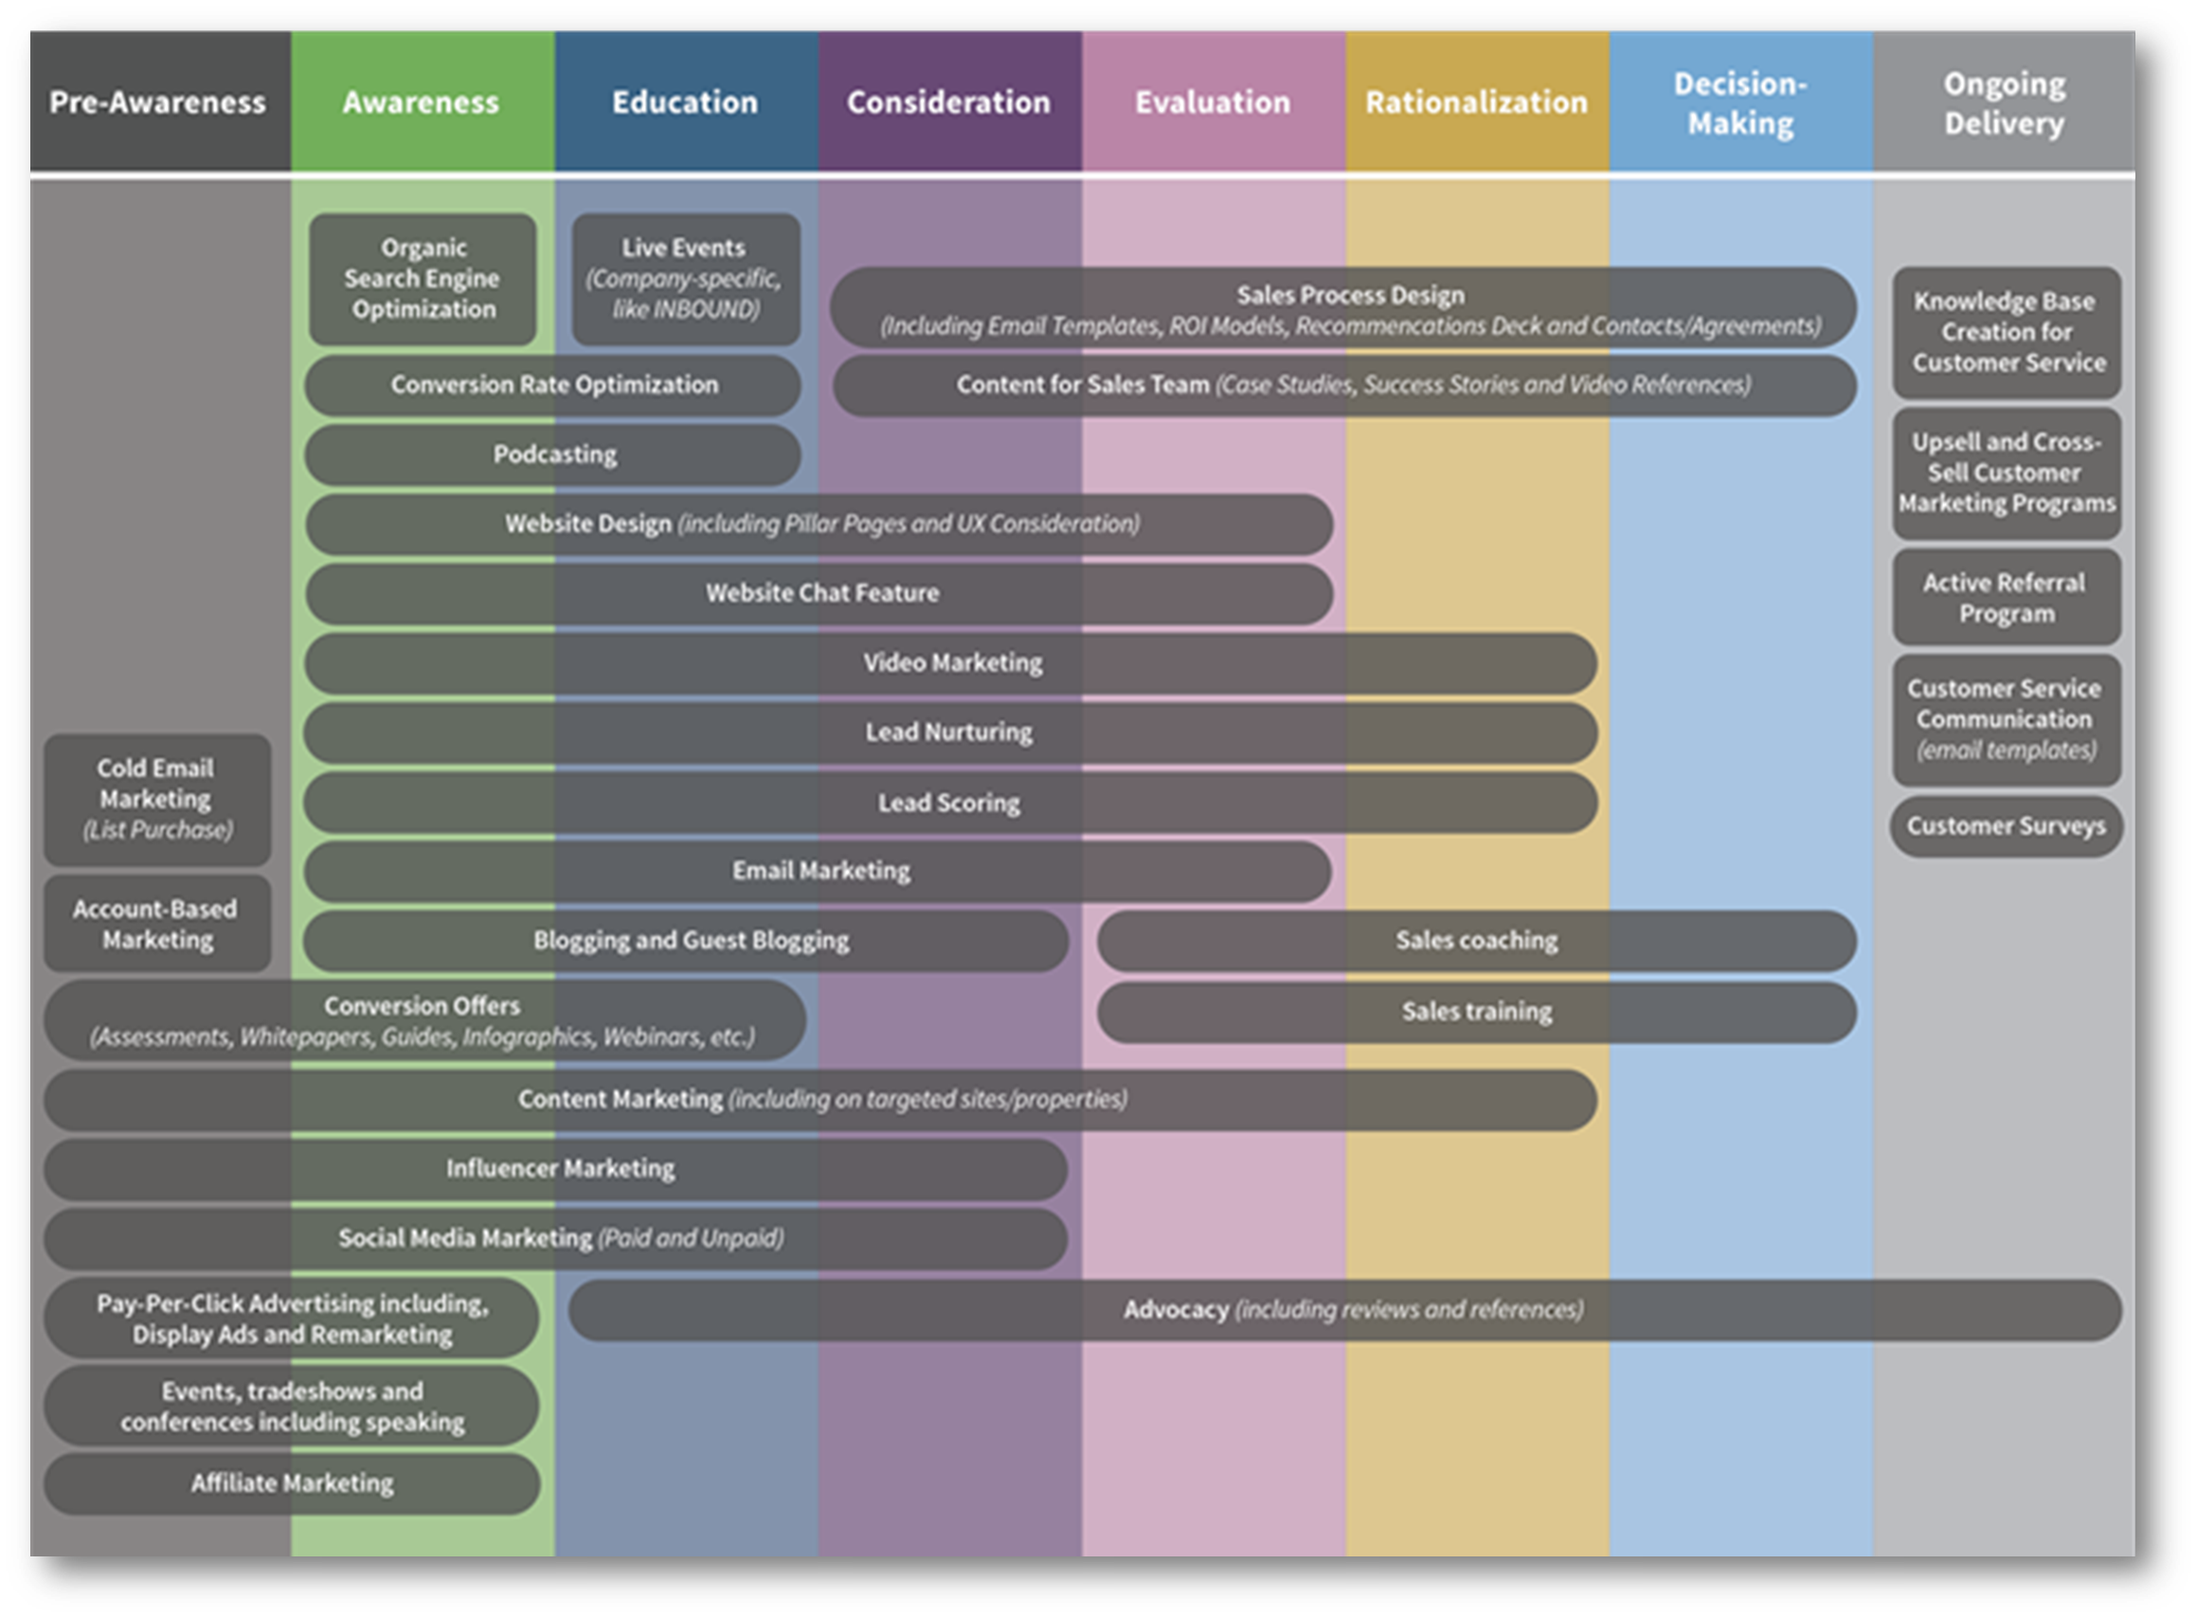
A BUYER-JOURNEY-CENTRIC APPROACH TO SOFTWARE AND TECHNOLOGY

Slide 65



























A BUYER-JOURNEY-CENTRIC APPROACH TO SOFTWARE AND TECHNOLOGY

Slide 66
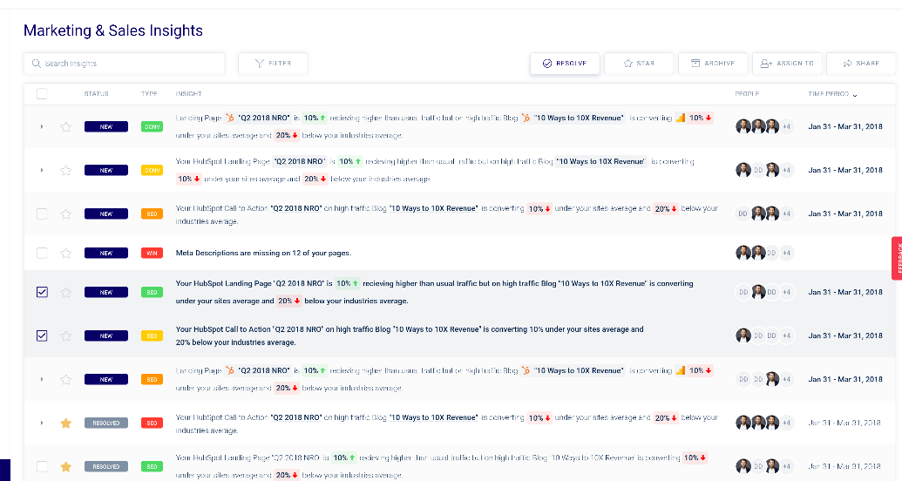
5
BONUS SECTION
HOW TO KNOW WHAT TO DO AND WHEN TO DO IT
A Methodology Around Prioritizing What Tactics Are Going To Produce The Biggest Results For The Least Amount Of Effort

Slide 67

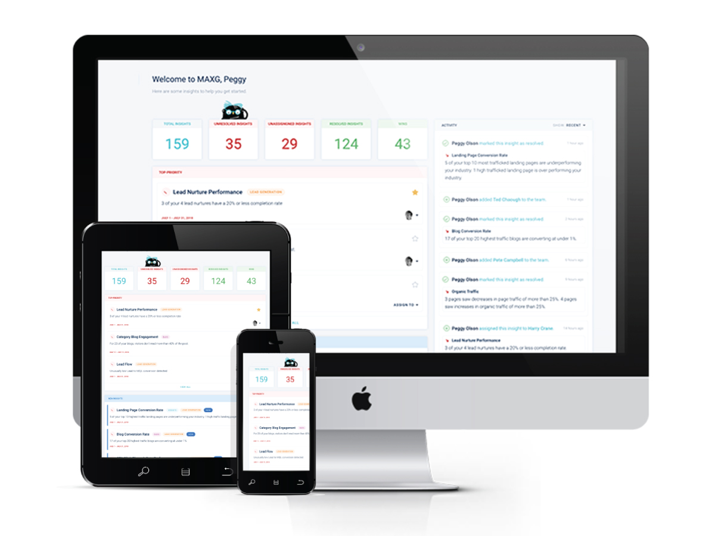

INTRODUCING
MARKETING ADVISOR FOR EXPONENTIAL GROWTH
THE NEW SOFTWARE TO DRIVE REVENUE
“I’ll take your sales and marketing data, marry it with industry-specific benchmark data and align it with your stated business goals.
Then I’ll give you prescriptive program recommendations that are based on thousands of experiences using a variety of sales and marketing tactics to drive revenue.
I’ll help you figure out what to do, when to do it and how to prioritize all of the marketing, sales and service tactics to drive revenue growth.”

Slide 68

SMASH THE FUNNEL – THE BOOK
FREE COPY OF OUR NEW BOOK
Smash The Funnel
FREE TRIAL TO MAXG
Get The Data Insights You Are Looking For!

Slide 69
QUESTIONS?
THANK YOU!

Slide 70
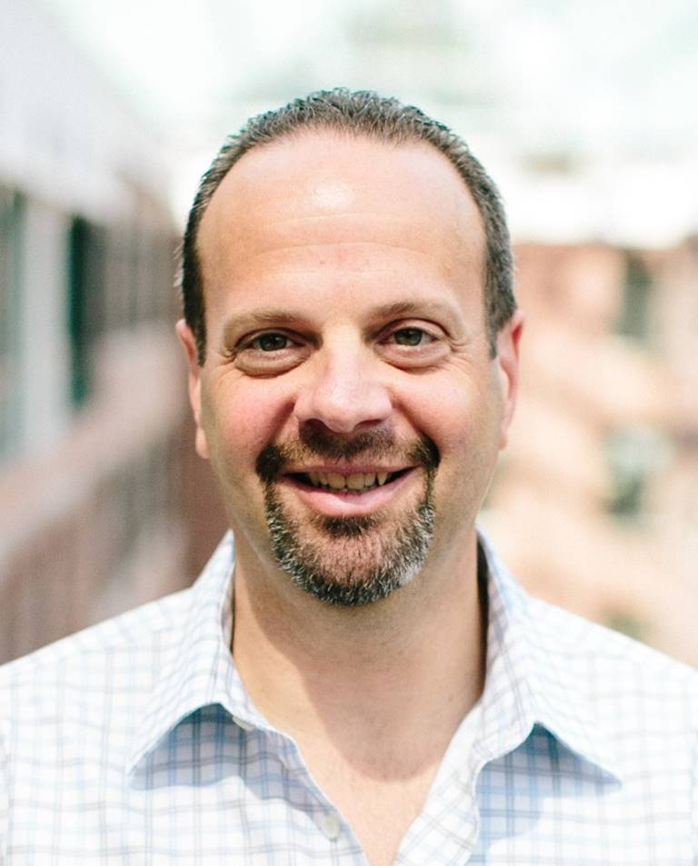
THANK You!
Let’s SMASH YOUR FUNNEL
MIKE LIEBERMAN
CEO And Chief Revenue Scientist
Square 2 Marketing
555 East North Lane, #5050
Conshohocken, PA 19428
mike@square2marketing.com
www.square2marketing.com

Slide 71
15 MINUTE
BREAK

Slide 72
SMASH THE FUNNEL: CREATING YOUR 2020
MARKETING STRATEGY
ERIC KEILES
CHIEF MARKETING OFFICER
SQUARE 2 MARKETING

Slide 73
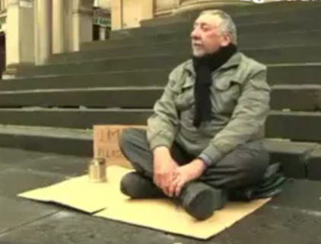

Slide 74
"IF YOU HAVE NOTHING INTERESTING TO SAY ABOUT YOUR BUSINESS, DO NOT SPEND ANY MONEY ON MARKETING.”
ME

Slide 75
SEVEN STEPS TO
CREATING YOUR 2020
MARKETING STRATEGY

Slide 76


Slide 77
IMPROVEMENT #1
WRITE DOWN THREE (3)
WAYS YOUR COMPANY IS REMARKABLE

Slide 78

IMPROVEMENT #2
PERSONA: WHO ARE
YOU TARGETING?

Slide 79

PERSONA
DEMOGRAPHIC
Who Are They?
What Are Their Titles?
PSYCHOGRAPHIC
What Do They Think?
Where Are They Located?
What Are Their Pains?
Where Do They Go For Content?
How Do They Want To Receive Information?
JASON, CIO

Slide 80
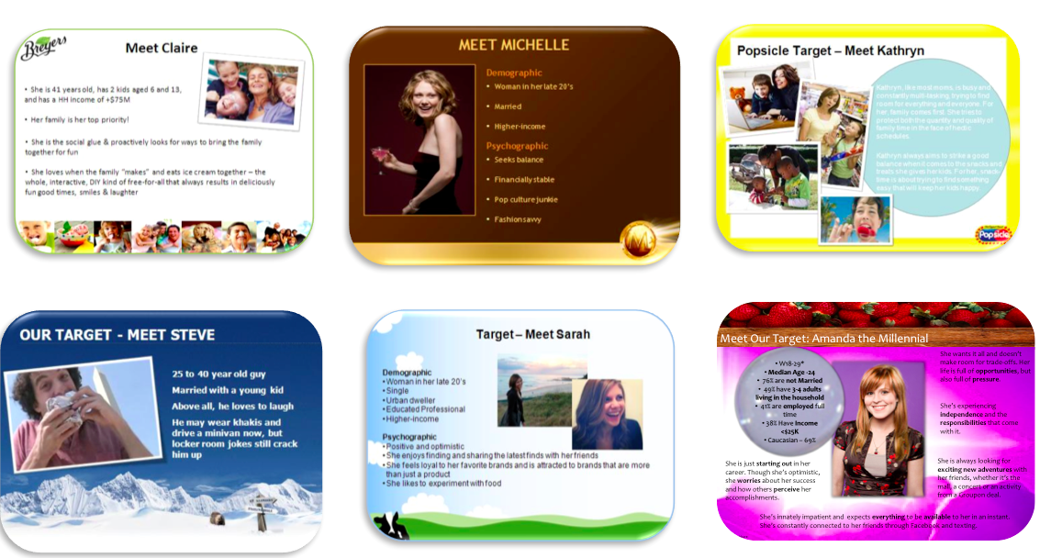


Slide 81
IMPROVEMENT #2
CREATE A DESCRIPTION OF YOUR FAVORITE CLIENT

Slide 82
"NO PURCHASE IS EVER MADE UNLESS IT MAKES
A PAIN OR PROBLEM
GO AWAY.”
ME

Slide 83

IMPROVEMENT #3
LIST THE 2-3 MOST COMMONLY HEARD
PAINS/PROBLEMS

Slide 84
IMPROVEMENT #4
EDGECRAFTING

Slide 85
IMPROVEMENT #5
HEADLINES

Slide 86
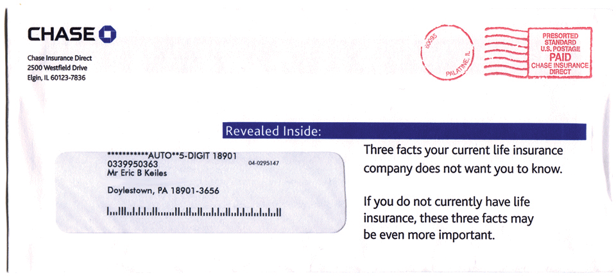

Slide 87
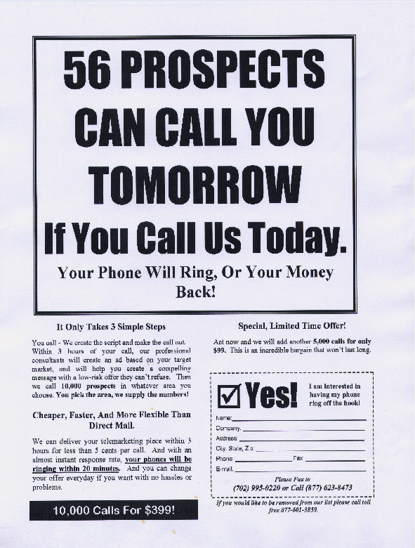

Slide 88


Slide 89
IMPROVEMENT #5
CREATE AN
EMOTIONALLY-CONNECTING HEADLINE THAT ENCAPSULATES EVERYTHING YOU DO FOR CLIENTS

Slide 90
IMPROVEMENT #6
OFFERS & CALL TO ACTION

Slide 91
THE CYCLONIC BUYER JOURNEY™

Slide 92
PRE-AWARENESS
EVALUATION
AWARENESS
RATIONALIZATION
EDUCATION
DECISION
CONSIDERATION
DELIVERY
MARKETING
SALES
SERVICE

Slide 93

OFFERS
AWARENESS 🡪 EDUCATION
(EARLY STAGE)
GOAL: CONVERT FROM WEBSITE VISITOR INTO
DATABASE LEAD
OFFERS: WHITE PAPERS, E-BOOKS,
FREE REPORTS, TIP SHEETS, INFOGRAPHICS…

Slide 94


Slide 95
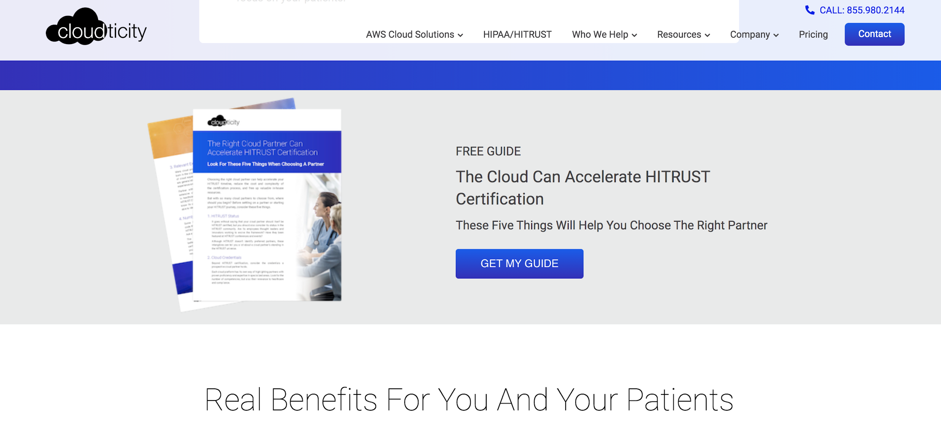

Slide 96


Slide 97
IMPROVEMENT #6
CREATE THE TITLE OF YOUR “EARLY STAGE OFFER”

Slide 98

NURTURE

Slide 99

NURTURE

Slide 100









Slide 101

Notes:
Eric

Slide 102
Every touchpoint represents an opportunity to be remarkable!
Notes:
Eric

Slide 103
LET’S BRING IT
ALL TOGETHER

Slide 104

I JUST MOVED!

Slide 105

WHAT WAS I
CONCERNED ABOUT
(PAINS AND PROBLEMS)?

Slide 106
PAINS:
Please don’t break my stuff
Please don’t mess up my house (new or old)
Please be on time and on schedule
Please don’t steal my stuff

Slide 107


Slide 108


WHICH COMPANY IS REMARKABLE?

Slide 109


Slide 110


Slide 111


Slide 112


Slide 113
WHO’S THE OBVIOUS CHOICE?

Slide 114

MARKETING
MACHINE

Slide 115
STRATEGY HOMEWORK
Create your marketing strategy (four key questions)
Create a “No Risk Offer” and put it on your website
Get three (3) testimonials from clients (with their video!)
Think of two (2) programs that can position your company as remarkable
Go back and review all of your marketing materials and make sure they focus on what your clients’ problems are
Improve your execution to make sure clients refer you via “word-of-mouth”
Notes:
Mike

Slide 116






SELFIE TIME!

Slide 117
SMASH THE FUNNEL – THE BOOK
FREE COPY OF OUR NEW BOOK
Smash The Funnel
FREE Trial TO MAXG
Get The Data Insights You Are Looking For!

Slide 118

THANKS!
ERIC KEILES
Chief Marketing Officer
Square 2 Marketing
555 East North Lane, #5050
Conshohocken, PA 19428
eric@square2marketing.com
www.square2marketing.com

Slide 119
SMASH THE FUNNEL: REAL-WORLD RESULTS
ANGELA POINTON
PRESIDENT
11OUTOF11

Slide 120


Slide 121


Slide 122


Slide 123

RESULTS:
5X Traffic
182 Leads
77 New Contacts

Slide 124


Slide 125


Slide 127


Slide 128


Slide 129


Slide 130


Slide 131

RESULTS:
200 Leads
Higher close rate
Growth within accounts

Slide 132

THANKS!
ANGELA POINTON
President
11outof11
610-329-0299
angela@11outof11.com

